Slide 1

Final Presentation
FOR EPILEPSY CLASSIFICATION
Presented by:
AMOURI Houssein
BEN NEJI Mohamed
DRISS Mohamed Ahmed
Under the Supervision of:
Dr. NCIB Lotfi
Mr. MLAOUAH Ayoub
GAYAP Hadrien
LONTCHI Freddy
SBOUI Mohamed Kadhem

Slide 2

Plan
I. Introduction
II. Business understanding & Data Science objectives
III. Data Preparation
IV. Data Modeling & Evaluation
V. Data Visualisation
VI. Conclusion & Perspectives

Slide 3
INTRODUCTION

Slide 4

Introduction
Approximately 65 million people suffer from epilepsy.
It affects people of all ages.
Epilepsy detection is a manual and tedious work for neurologists.

Slide 5
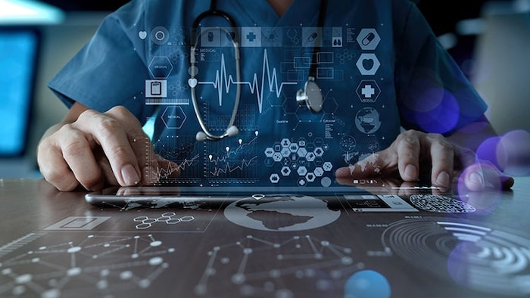
Project Context
Automated System for Epilepsy detection
Why use an automated system?

Slide 6
II. Business Understanding & Data Science Objectives

Slide 7
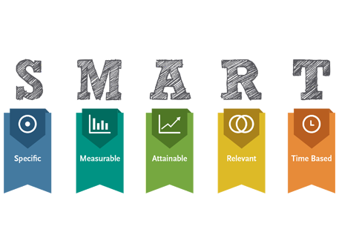
Business Understanding

Slide 8
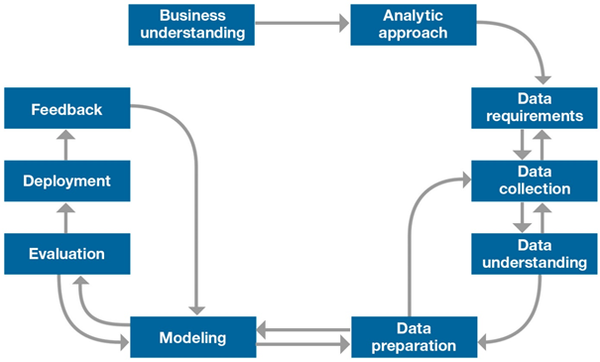
IBM MASTER PLAN

Slide 9
Data Science Objectives
Adapting the current deep learning solutions to our subject.
Practicing new deep learning techniques.
Fully automating the analytical process for epilepsy detection.
Developing an application that has the best accuracy possible.

Slide 10
III. Data Preparation

Slide 11
Data Preparation
Channels
selection
Filtering
Artifact
Correction
Features
Extraction

Slide 12
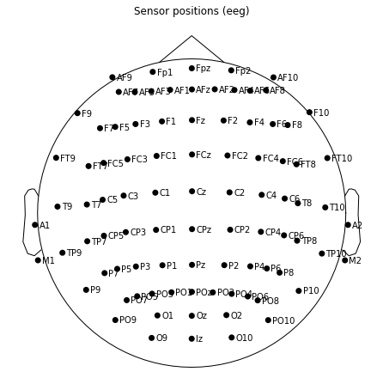
Channels Selection
We have extracted all the electrodes that appear throughout the whole data.

Slide 13
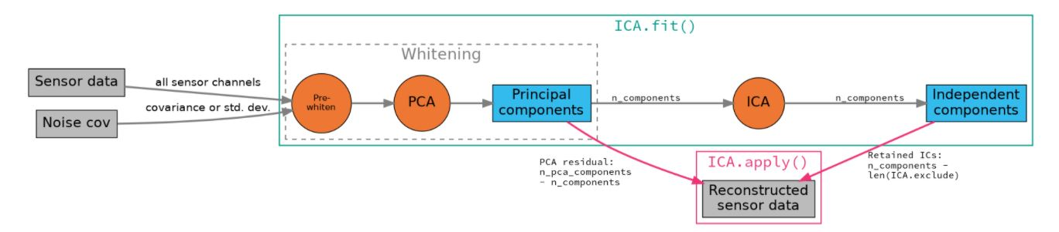
ICA
Independent components analysis (ICA) is a technique for estimating independent source signals from a set of recordings in which the source signals were mixed together in unknown ratios.
When using ICA, we use the Principal Component Analysis or PCA to seperate each inidividual component which in our case represent the electrodes.

Slide 14
IV. Data Modeling & Evaluation

Slide 15
Data Modeling
When choosing our models we came to the decision that we use these three :
CNN with ICA images
Transfer Learning
CNN with specters

Slide 16
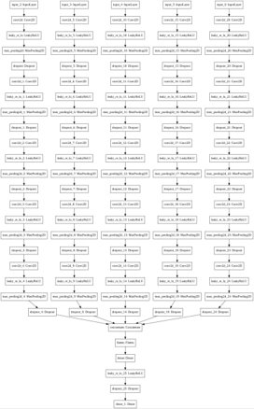
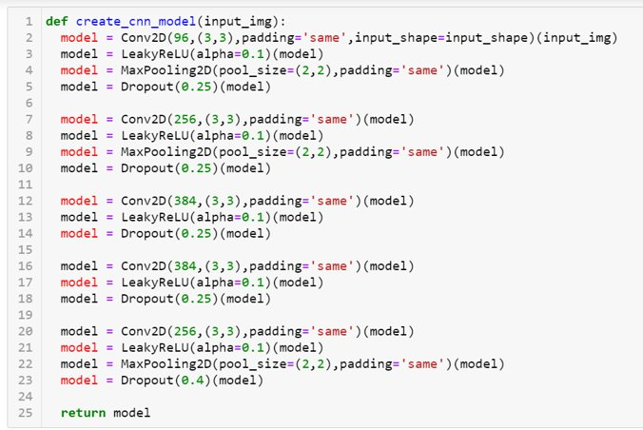
CNN with ICA Images
For this model we had to create a single CNN model for each electrode and then concatinate all of them into one final model.

Slide 17
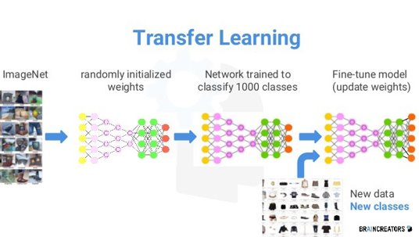
Transfer Learning
We used three different pre-trained models in this process and then chose the best out them :
VGG16
Mxnet
XCeption

Slide 18
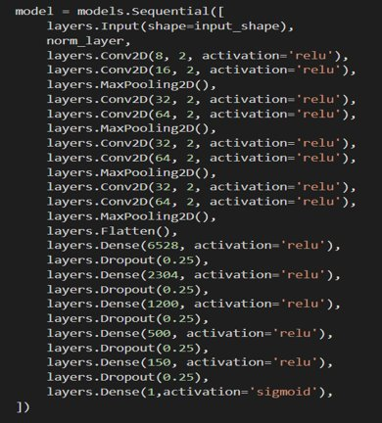
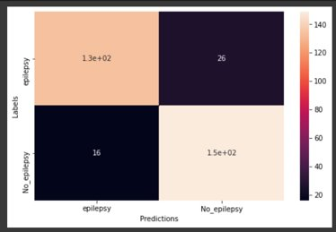
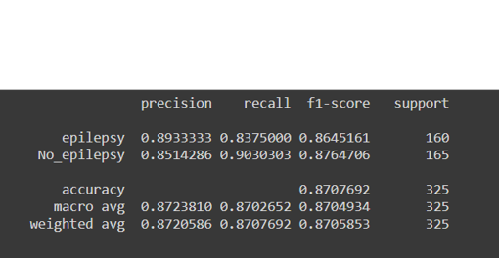
CNN with specters
For our last test model, we replaced our ICA images into specters and created a CNN model for them.

Slide 19
Evaluation
Model | Accuracy
CNN with ICA images | 0.78
Transfer Learning | 0.7905
CNN with specters | 0.8723
We chose CNN with specters because it presented the best accuracy .

Slide 20
V. Data Visualization

Slide 21
Data Visualisation
In the deployment part we chose to divide our interface into two types using django :
An interface dedicated to the specialist which are neurologists.
An interface dedicated for the patients.

Slide 22
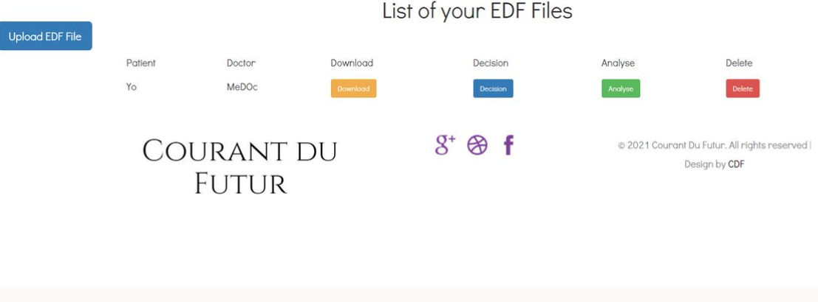
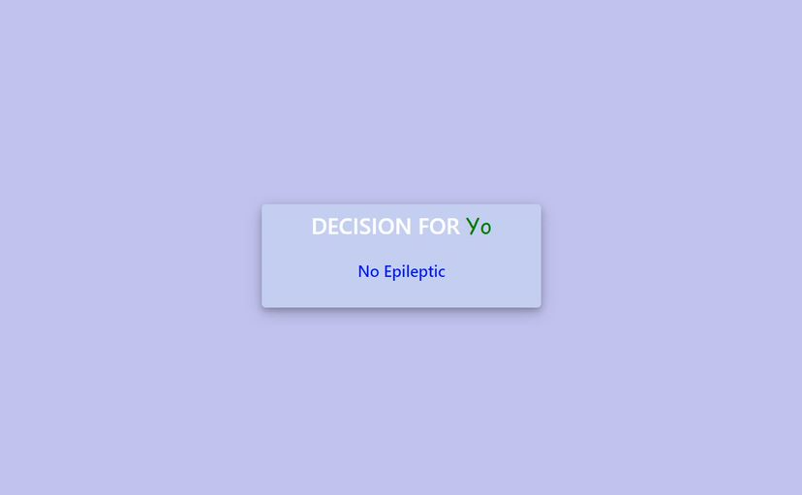
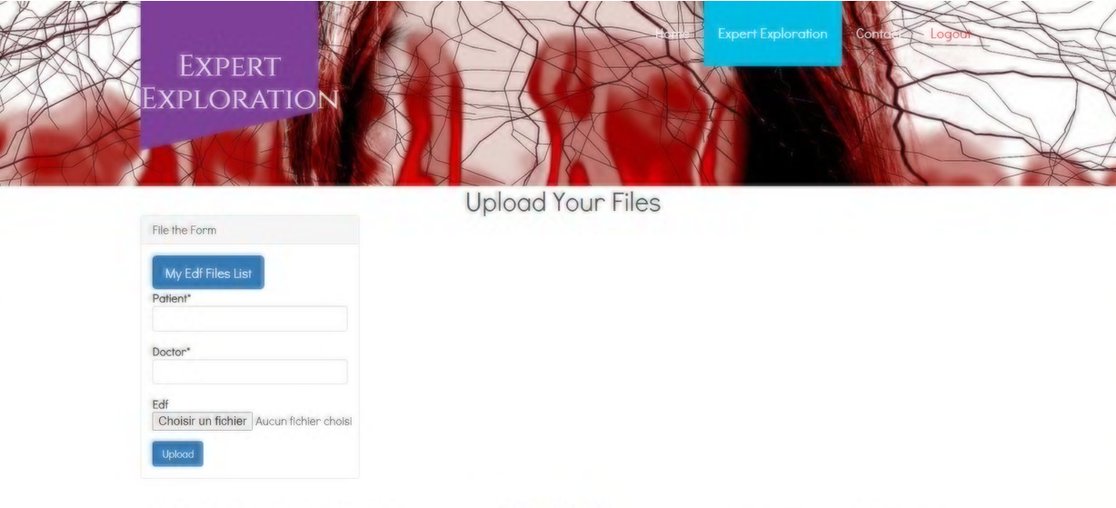
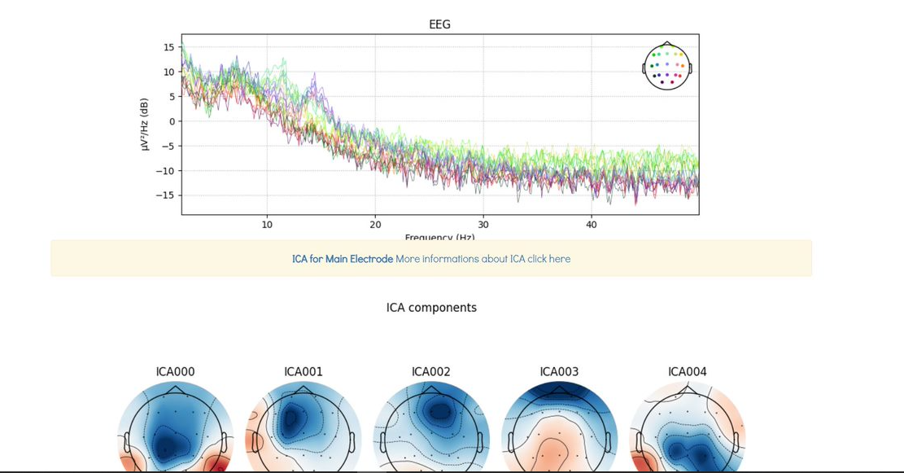

Slide 23
VI. Conclusion & Perspective

Slide 24
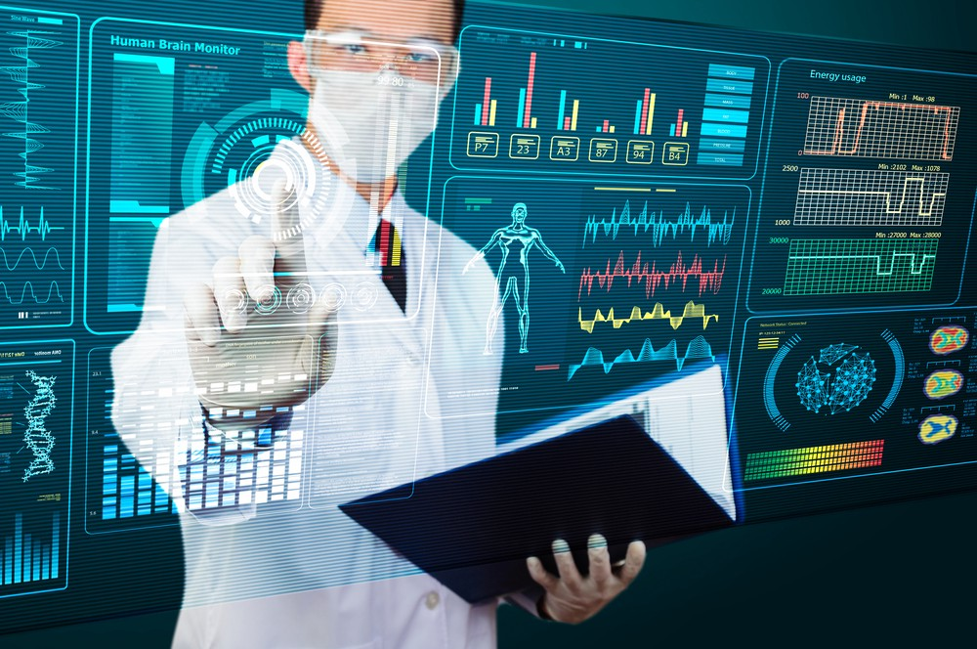
Conclusion & Perspective
Practice the new deep learning techniques we learned
Hence getting more experience
Resolve a common issue in the health departement.
We could improve our work by implementing a functionality that allows us to detect incoming seizures.

